Slide 1
BROTHER IN LOVE TURKISH MOVIE
Student’s Name
Institution
Course Title
Assignment title
Date

Slide 2

HISTORY AND THEME REVIEW
Turkish movies are interesting to watch where they combine various concepts such as comic, drama and romance.
Brother in love movie combines all the aforementioned concepts.
The primary theme of the film is love that shapes the storyline of the film.
The theme of deception also arises where the main character is caught between love and material benefit.
Violence theme is also used in the film and depicted as inevitable in the modern world.
Notes:
Turkish movies are interesting to watch where they combine various concepts such as comic, drama and romance. Brother in love movie combines all the aforementioned concepts. The primary theme of the film is love that shapes the storyline of the film. Moreover, The theme of deception also arises where the main character is caught between love and material benefit. Since there are some instances of robbery in the movie, violence theme is highlighted and depicted as inevitable in the modern world.

Slide 3
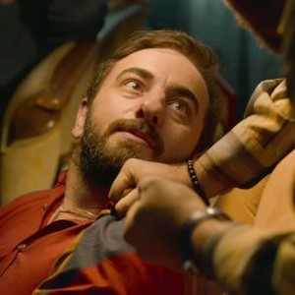
MOVIE ANALYSIS
The movie uses traditional directing style where casts follow the scripts.
The music in the film helps to create different moods such as somber mood.
The lighting is effective throughout the film.
The camera positioning depends on the anticipated view.
The movie serves the intended purposes of entertaining.
Notes:
In the analysis, The movie uses traditional directing style where casts follow the scripts. The music in the film helps to create different moods such as somber mood. The lighting is effective throughout the film. The camera positioning depends on the anticipated view. The movie serves the intended purposes of entertaining and also educating the audience.

Slide 4
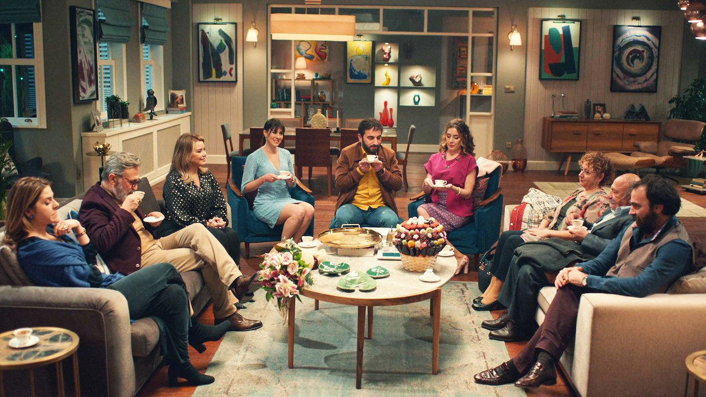
MOVIE PREVIEW
The movie is interesting to watch since the storyline is based on comic and romance.
The Turkish culture is also highlighted in the movie.
Basically the movie is suitable for general viewing.
Unlike some films, Brother in love does not contain absurd graphics.
The movie also educates on crucial societal concerns, such as, impact of violence.
Notes:
The previews of the movie include, that the movie is interesting to watch since the storyline is based on comic and romance. The Turkish culture is also highlighted in the movie. Basically the movie is suitable for general viewing and Unlike some films, Brother in love does not contain absurd graphics. The movie also educates on crucial societal concerns, such as, impact of violence.

Slide 5
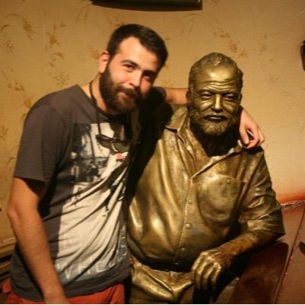
MOVIE’S DIRECTOR
Brother in love movie was directed by Onur Bilgetay.
Onur Bilgetay is among the significant directors across Turkey having directed several films.
Bilgetay used traditional directing style throughout the film.
Based on his vast experience, the directing style blended with the themes.
Directors plays a crucial role in determining the success of films.
Notes:
The director forms a crucial part in the creation of the movie. In the brother in love movie, the director was Onur Bilgetay. Onur Bilgetay is among the significant directors across Turkey having directed several films. Bilgetay used traditional directing style throughout the film. Based on his vast experience, the directing style blended with the themes. Directors plays a crucial role in determining the success of films.

Slide 6
Reference
Aykut Eniste (Brother in Love). (2019). Retrieved 4 August 2021, from https://www.imdb.com/title/tt10320050/

